Slide 1
Liberalism 1.0 Universidad Francisco Marroquin 7 August 2017
By Daniel Klein
Notes:
I am thrilled and grateful for this opportunity. Thank you all.

Slide 2
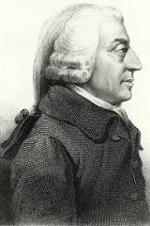
“classical liberalism”
Notes:
Sometimes, when we talk about “classical liberalism,” people say, “Oh, you’re just making it up.”
No, I think it is cogent. A civilizational arc that culminates in liberalism 1.0.
Adam Smith looms large.

Slide 3
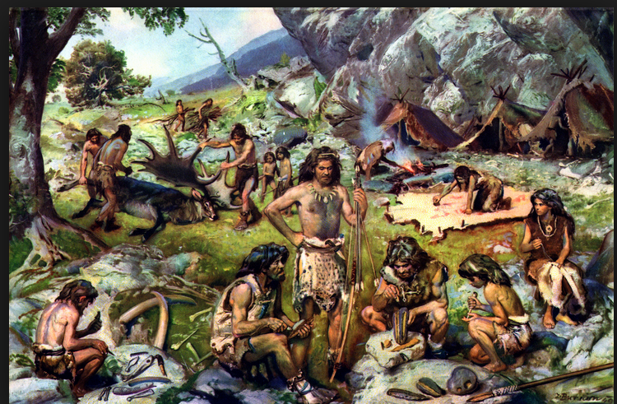
The ancestral band
Cohesionism
Notes:
I think our genes and instincts are rooted in the ancestral band. Our brains were selected for a small, simple social world of strong cohesion. As a result we have strong tendencies toward cohesionism in politics, tendencies that don’t fit modern life, tendencies we need to rechannel and subdue.

Slide 4
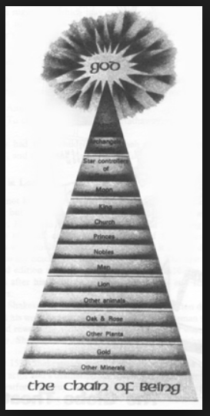
1440 AD
Traditional-society
cohesionism
Notes:
Now fast-forward to 1440. We are programmed to look for a shared vision of the good, a shared purpose, and a shared way of life. We naturally feel that the sharing should encompass our society.

Slide 5
High things, sacred things. Low things, mundane things.
Traditional-society
cohesionism:
High-things conformity,
uniformity
Notes:
Traditional societies inculcate shared understandings of the sacred things in life, producing conformity and uniformity in the higher things. The lower, mundane things of life are understood to serve the higher things. Again we see the impetus toward cohesionism.

Slide 6
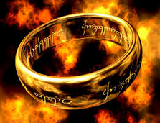
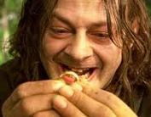
1440-1776
Gutenberg printing press 1440.
Protestant reformation: Innovation and secession from Roman Catholicism
Cuius regio, eius religio: Whose realm, his religion.
Wars of religion
An idea: Religious toleration
Another idea: Liberty of religion.
Separation of Church and State
Another idea: Liberty.
Separation of High Things and State.
Adam Smith:
“more difficult to preserve
this harmony [of sentiments]”
Meanwhile:
The rise of the nation-state
Notes:
The printing press empowered intellectuals to innovate and criticize traditional power.
There came innovation and secession from Roman Catholicism. But cohesionism was still the plan, just a different religious doctrine.
Cuius regio, eius religio COO-IUS REGIO AY-IUS RELIGIO. Whose realm, his religion.
People butchered each other in wars of religion, fighting over the ring of power.
Some intellectuals promoted religious toleration.
Then, liberty of religion, even a free market in churches and religion.
And then, a free-market, period. The separation of High Things and State.
Meanwhile, we had the rise of the nation-state.

Slide 7
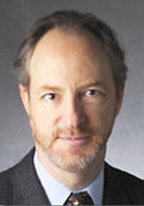
Arthur Melzer:
“[E]arly modern thinkers…endeavored to find a form of politics that could do without such consensus. They deliberately set out to subvert traditional society and to replace it with a fundamentally new kind of social organization, one that would renounce the ever precarious attempt to define the truth about life’s highest goods. Instead, it would unite men on the promise of preventing the most obvious and basic evils…Thus, by standing traditional society on its head, by openly switching the purpose and moral basis of the state from our highest to our lowest end, they attempted to separate politics from the whole disputed sphere of morality and religion…” (2014, 171)
Notes:
Arthur Melzer writes:

Slide 8
High things, sacred things. Low things, mundane things.
The low things
Clarifying pieces: Dividing and subdividing rights and duties
Basic rules: operating system
“the liberal plan”
dangers of discohesion
a faith in spontaneous order
Notes:
To refocus on the low things, they had to clarify them, by dividing and subdividing rights and duties.
To create basic rules, a basic operating system.
The basic operating would emerge as “the liberal plan.”
They were acutely aware of the dangers of discohesion.
But they had adequate faith in spontaneous order, good enough to justify movement in the liberal direction.

Slide 9
High things, sacred things. Low things, mundane things.
The liberal plan DOES monkey with the high-things space: It frowns on some of it, and seeks to condemn and preclude it.
The liberal plan does NOT forsake high things – virtue, right, (larger) justice, goodness.
It is better than the alternatives.
The liberal plan is NOT a maximand.
Notes:
The liberal plan DOES monkey…
Leo Strauss suggests that Smith does forsake, e.g., What Is Pol. Phil? P. 111.

Slide 10
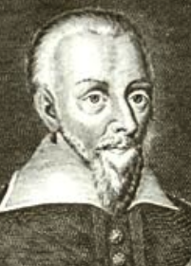
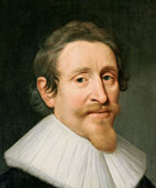
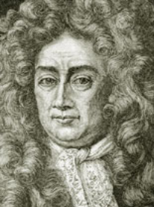
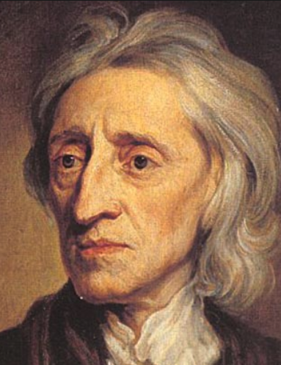
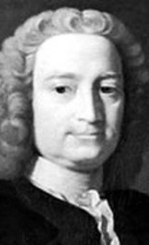
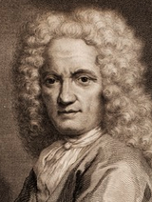
Samuel Pufendorf
Hugo Grotius
John Locke
Sebastian Castellio
“GOVERNMENT,
BACK OFF OF
THE HIGHER THINGS!”
Francis Hutcheson
Also:
Gershom Carmichael
Jean Barbeyrac
Notes:
These are some of the men who said: “Back off of the higher things!”

Slide 11
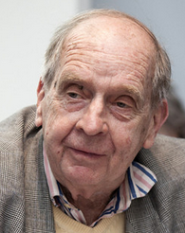
Larry Siedentop: Christianity made liberalism possible
By creating a humankind-encompassing
ethical backdrop to mitigate the discohesion
problems of liberalism
Notes:
Incidentally, the theme that Christianity made liberalism possible resonates with me.
Perhaps it did so by creating a humankind-encompassing ethical backdrop to mitigate the discohesion problems of liberalism.

Slide 12
Samuel Pufendorf
Hugo Grotius
John Locke
Sebastian Castellio
Duncan Forbes:
“Natural theology was the indispensable ground of natural law.” (42)
Francis Hutcheson
Also:
Gershom Carmichael
Jean Barbeyrac
Notes:
All of these guys were highly Christian, or at least professed to be so. And they wrote for christianized audiences.

Slide 13
Grotius et al:
Jurisprudence was brought into moral/political philosophy
Focus on “one’s own” (suum) and securing it against being messed with.
Focal rules emerge.
Only outward action is justiciable Puf Wh Duty “”the external Actions of Man”, TMS 104.1
Government’s job: Safeguarding suum
Notes:
The refocusing on lower-things amounted to making jurisprudence central in moral and political philosophy…

Slide 14
800 AD Feudalism Modern
(king)
Allodial Lord
serf
King
lords/nobles
serf
Governor (S)
citizen (i)
Jurisprudence
highlights the
awfully special
nature of
government.
Notes:
Smith and others tell a story about the emergence of the modern nation-state, and points toward the promise of a governor or jural superior practicing liberal policy and liberal politics.
Meanwhile, jurisprudence highlights the awfully special nature of government.

Slide 15
Grotius as modern
The jurisprudential element in moral philosophy is distinctive to modern thought.
Liberalism 1.0 is distinctively modern.
“Classical liberalism” is modern.
Notes:
The jurisprudential element in moral philosophy is distinctively modern.
Liberalism 1.0 is distinctively modern.
“Classical liberalism” is modern. So the term “classical liberalism” is awkward and can be confusing.

Slide 16
Grotius, Pufendorf, Locke:
NOT a world of political stability
Origination story:
“state of nature” → political society
Social contract, political consent
Notes:
These guys did not live in a world of political stability, and they strove for a stable polity.
They tell origination or “state of nature” stories about the forming of political society. SOCIAL CONTRACT

Slide 17
Grotius, Pufendorf, Locke:
Social contract/political consent
– two purposes of:
Submit to the government
Justify ousting the government
Notes:
I propose that we view that as a myth-making ploy suitable to the situation of lack of stable polity.
Contract was venerable and solemn. They invoked the prestige of contract for two reasons, corresponding to the duties on either side of a contract:
To tell citizens that they have bound themselves by contract, and thus to impress upon them their duty to go along with the government.
To contend that a bad government violated the contract, and to justify the ousting of the bad regime and the installating of a new one.

Slide 18
Stable polity in Britain
We understand Hume and Smith better than we do Grotius and Locke because Hume and Smith presuppose a stable polity context.
Notes:
Not long after the Glorious Revolution, Britain attained robust political stability. Our next heroes, Hume and Smith, lived in and wrote for such a world, presupposing a stable polity. That is one reason why we find it much easier to understand Hume and Smith than to understand the 17th century writers.

Slide 19
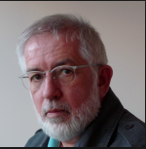
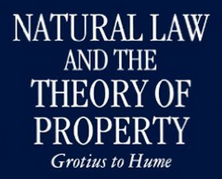
Stephen Buckle
Also:
Duncan Forbes
Knud Haakonssen
etc.
Notes:
But still there is strong continuity from them to Hume and Smith., as Stephen Buckle, for example, shows.

Slide 20
Some genealogy of liberalism 1.0
“proto-liberals”
→ Political stability in Britain
Grotius-Locke-Hume
Hume-Smith
“liberal” as the name
1600 1689 1776 …. Gladstone….
We extend “liberal” backward in time, before 1776
Notes:
Grotius-Locke-Hume are a tradition…
We extend “liberal” back before 1776.
“proto-liberals”

Slide 21
(before Grotius)
Original Sources | Modern Scholars
Decretum Gratiani (1150) | Gierke, Maitland, Maine
Henry of Ghent (b. 1217); Aquinas (b. 1225); Duns Scotus (b. 1266); Marsilius of Padua (b. 1275); Ockham (b. 1287); | Walter Ullman, Colin Morris
Gerson (b. 1363) | Alan Macfarlane, Brian Tierney, Harold Berman
Vitoria (b. 1483), Las Casas (b. 1484), Suarez (b. 1548)

Slide 22
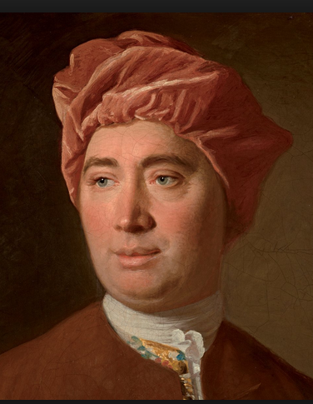
David Hume 1711-1776

Slide 23
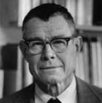
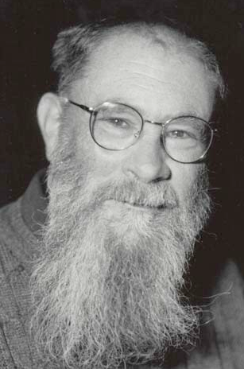
David Hume
Thomas
Schelling
1921-2016
Problems in mutual coordination
Focal points (Schelling)
Focal points all the way down.
Convention: Language, etc. (D.K. Lewis)
Does not imply contract/consent.
David K.
Lewis
Convention
Consent
Notes:
He fathomed questions of mutual coordination about as brilliantly as anyone prior to Thomas Schelling.
He tended to see things as focal points all the way down.
He spoke of language as convention, like David K. Lewis later.
Convention does not imply contract or consent, it is a broader concept.

Slide 24
David Hume
Natural convention
Commutative justice: A set of conventions.
Political authority: A set of conventions.
He attacks social contract
“liberty is the perfection of civil society” Essays, 41
Convention
Consent
Notes:
Some conventions are natural, in the sense that they are quite necessary to any social system that survives, and in that sense universal.
He attacked social contract and instead interpreted political authority in conventionalist terms. So political authority would be here, as conventional but not a matter of contract or consent.
And he did likewise for commutative justice.
He said liberty was the perfection of civil society, but he knew that perfection was something not fully attainable and that the very idea of such perfection was fraught with internal tensions and paradoxes.

Slide 25
Lord Blackstone
"There is indeed some difference among the writers on natural law, concerning the reason why occupancy should convey this right, and invest one with this absolute property: Grotius and Pufendorf insisting, that this right of occupancy is founded upon a tacit and implied assent of all mankind, that the first occupant should become the owner; and Barbeyrac, Titius, Mr. Locke, and others, holding, that there is no such implied assent, neither is it necessary that there should be; for that the very act of occupancy, alone, being a degree of bodily labor, is from a principle of nature justice, without any consent or compact, sufficient of itself to gain a title. A dispute that favors too much of nice and scholastic refinement!” Commentaries, Bk2, ch1

Slide 26
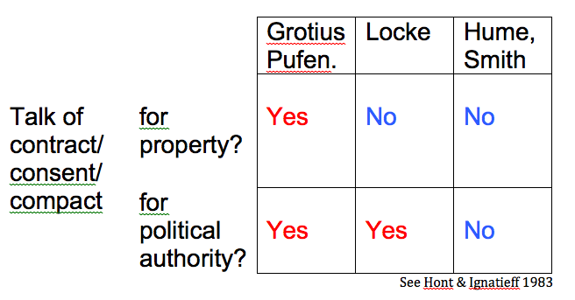

Slide 27
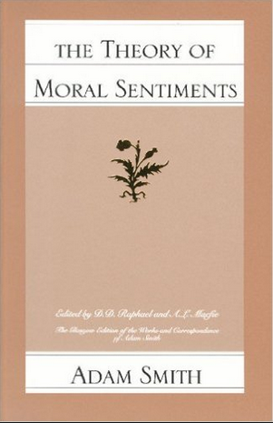
Adam Smith 1723-1790
Treats virtues
you are to practice

Slide 28
Commutative justice
“The most sacred laws of justice…are the laws which guard the life and person of our neighbour; the next are those which guard his property and possessions; and last of all come those which guard what are called his personal rights, or what is due to him from the promises of others.”
Notes:
Commutative justice a one of those virtues you are to practice…

Slide 29
Adam Smith
Commutative justice:
Not messing with
other people’s
stuff
Understood within historical context.
Uniformity amidst variety.
Government law affects fine points but does not undo natural conventions
Notes:
…
General formulation but…
Uniformity amidst diversity.
Government law affects fine points but does not undo natural conventions

Slide 30
Commutative justice
Not messing with
other people’s
stuff
CJ is special among the virtues
CJ plays special roles within TMS
Notes:
CJ is special among the virtues.
CJ plays special roles within TMS.

Slide 31
Two jural relationships
the Equal-Equal relationship (E-E)
the Superior-inferior relationship (S-i)
Notes:
One of the special roles is to distinguish two sorts of jural relationships…

Slide 32
Specialness of CJ
Unlike the rules of all the other virtues, the rules of CJ are “precise and accurate.”
→ “perfect” right
The actions it treats are ones we are not to do; doing nothing (passiveness) is often sufficient to fulfilling CJ.
Feedback on one’s performance of CJ is only negative (or neutral).
Notes:
Smith emphasized the specialness of CJ…

Slide 33
Specialness of CJ
In E-E, an observance of the rules of CJ is “indispensable” -- otherwise society degenerates.
In E-E, we feel a stricter obligation to observe CJ than other virtues; indeed, CJ may be forced.

Slide 34
Specialness of CJ
The formulation of CJ admits of a flipside: Others not messing with your stuff
In E-E: “security”
In S-i: “liberty,” “natural liberty.”
“Both laws were evident violations of natural liberty, and therefore unjust” (WN, 530.16)

Slide 35
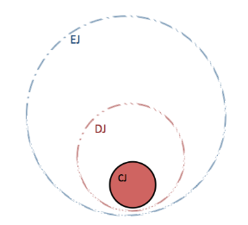
“…and the pursuit of happiness”
“life, liberty,”
Notes:
“life, liberty, and the pursuit of happiness”

Slide 36
Earnings: Income acquired within commutative justice
Jurisprudence taught commutative justice.
That idea shaped people’s thinking about money earned
→ earnings

Slide 37
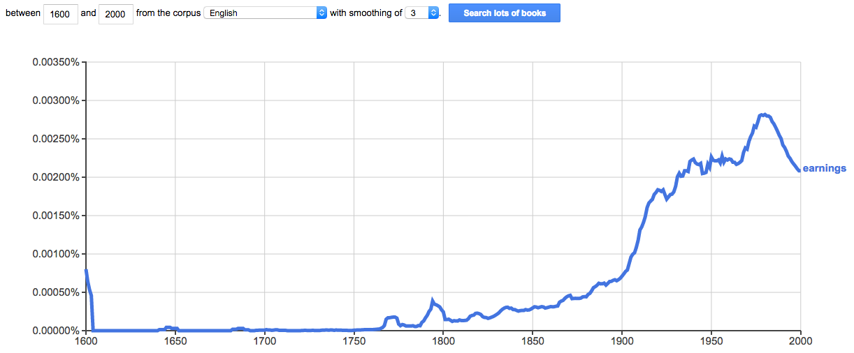
“earnings” starts around 1770

Slide 38
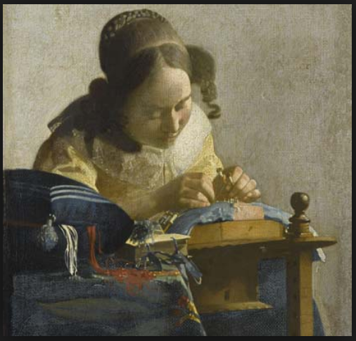
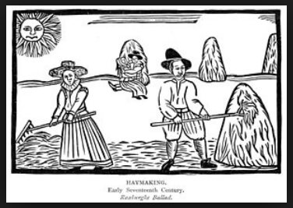
Calling had received Christian sanctification

Slide 39
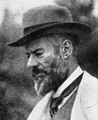
Max Weber
The Protestant ethic “interpreted the employer’s business activity as a calling.”
Also:
“The treatment of labour as a calling became as characteristic of the modern worker as the corresponding attitude toward acquisition of the business man” (178-79).
Pursuit-of-honest-income—though a fluid activity—received calling sanctification.
Gesellschaft/“commercial society”: An abstraction begotten by jurisprudence.

Slide 40
Max Weber
This sanctification brought the sanctification of entrepreneurial discovery and innovation.
If God “shows one of His elect a chance of profit…the faithful Christian must follow the call by taking advantage of the opportunity” (162).

Slide 41
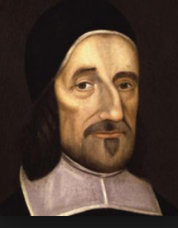
Richard Baxter (1615-1691)
“If God show you a way in which you may lawfully get more than in another way (without wrong to your soul or to any other), if you refuse this, and choose the less gainful way, you cross one of the ends of your calling, and you refuse to be God’s steward, and to accept His gifts and use them for Him when He requireth it: you may labour to be rich for God, though not for the flesh and sin.” (quoted in Weber p. 162)

Slide 42
J.G.A. Pocock
“The child of jurisprudence is liberalism, in which the disjunction between individual and sovereign remains, no matter how close the two are brought to one another; whereas republican virtue pertains immediately to the individual, not as proprietor or rights-bearer but as citizen, sharing self-rule among a number of equals without the need of any prior translatio.” (essay in Hont & Ignatieff 1983, 249)

Slide 43
Dugald Stewart
The systems of natural jurisprudence were “the first rudiments…of liberal politics taught in modern times.” (CW I, p. 26, see also 183)
And to which “we are chiefly indebted for the modern science of Political Economy” (p. 171)

Slide 44
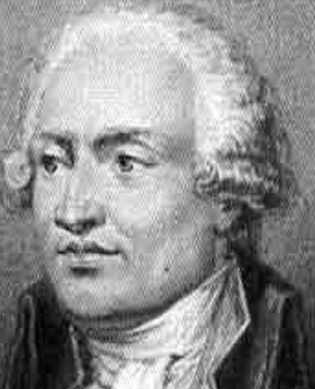
Condorcet
Of the 16th century:
“The science of political economy did not, in this epoch, exist.”

Slide 45
Hume
“Trade was never esteemed an affair of state till the last [the 17th] century; and there scarcely is any ancient writer on politics, who has made mention of it.”

Slide 46
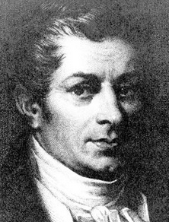
J.B. Say
“[U]ntil the epoch of [the publication of The Wealth of Nations], the science of political economy did not exist.”

Slide 47
Smith, WN
The spine of liberalism 1.0 is CJ/liberty.
Presumption of liberty: The burden of proof is on the contravener of the principle.
WN morally authorizes pursuit of honest income and the presumption of liberty.

Slide 48
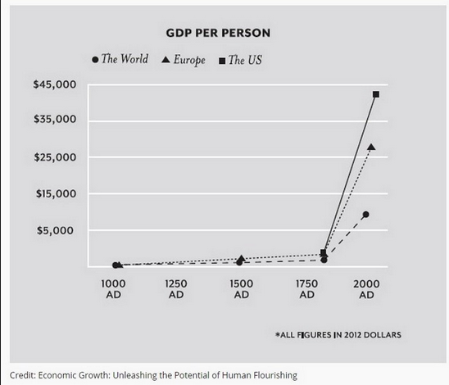
The Great Enrichment

Slide 49
Smith, WN
Establishes “liberal” as signifier
→ liberalism

Slide 50
Youtube videos
A Plea Regarding “Liberal”
The Emergence of “Liberal” as a political term
At New Media UFM:
Semantic History of Liberalism
Notes:
In other work I have shown that Smith and friends established a political meaning of “liberal”

Slide 51
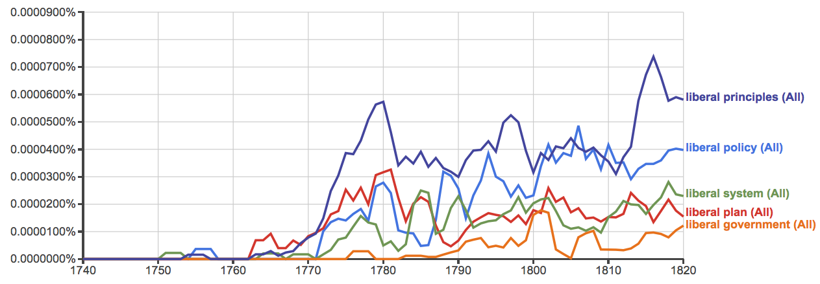
“liberal” blossoms

Slide 52
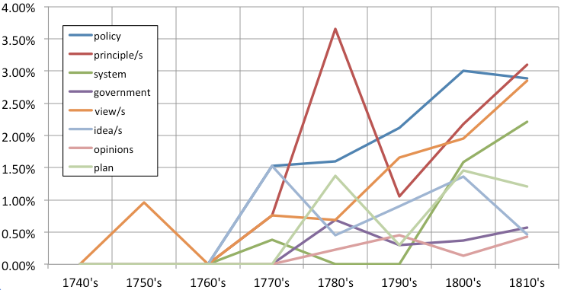
% of political collocating nouns out of top 100 collocating nouns, by decade

Slide 53
“the liberal plan”
“the liberal plan of equality, liberty, and justice”
“allowing every man to pursue his own interest his own way”
“of its/their own accord” – 28 in WN
Ascendancy: intellectual, cultural, even governmental.
Notes:
Smith spoke of “the liberal plan…”
When we speak of the 17th, 18th, and 19th centuries as “the liberal period” we mean that movement was in the liberal direction, we don’t mean a period of comprehensive liberalism. Up to the 1880s or so there was an ascendancy of liberal sensibilities.

Slide 54
“the liberal plan”
“plain and intelligible to common understandings”
A simple formula?
Complications…
Notes:
He said that the basic principles were “plain…”

Slide 55
Valuable distinctions
E-E jural relation versus S-i jural relation.
Stable polity versus not. (Strong/weak govt, etc.)
Science of a legislator versus the art of liberal politics.
Non-aggression axiom versus the liberty principle.
Liberty principle versus liberty maxim.
Direct versus overall liberty: “A great sacrifice of liberty must necessarily be made in every government” (Hume, Origin of Govt)

Slide 56
Overall-liberty versus desirability.
Presumption of liberty versus the presumption of the status quo.
Liberty versus independency.
Bargaining versus challenging (and the hybrid, royalty).
5th-best versus 17th-best. (Political feasibility; Cowen “practical advocacy”)
Exoteric versus esoteric.

Slide 57
Liberalism 1.0 survives all of the complications.
Big-tent liberalism 1.0:
Its posture is opposition to the governmentalization of social affairs.
Directional, not destinational

Slide 58
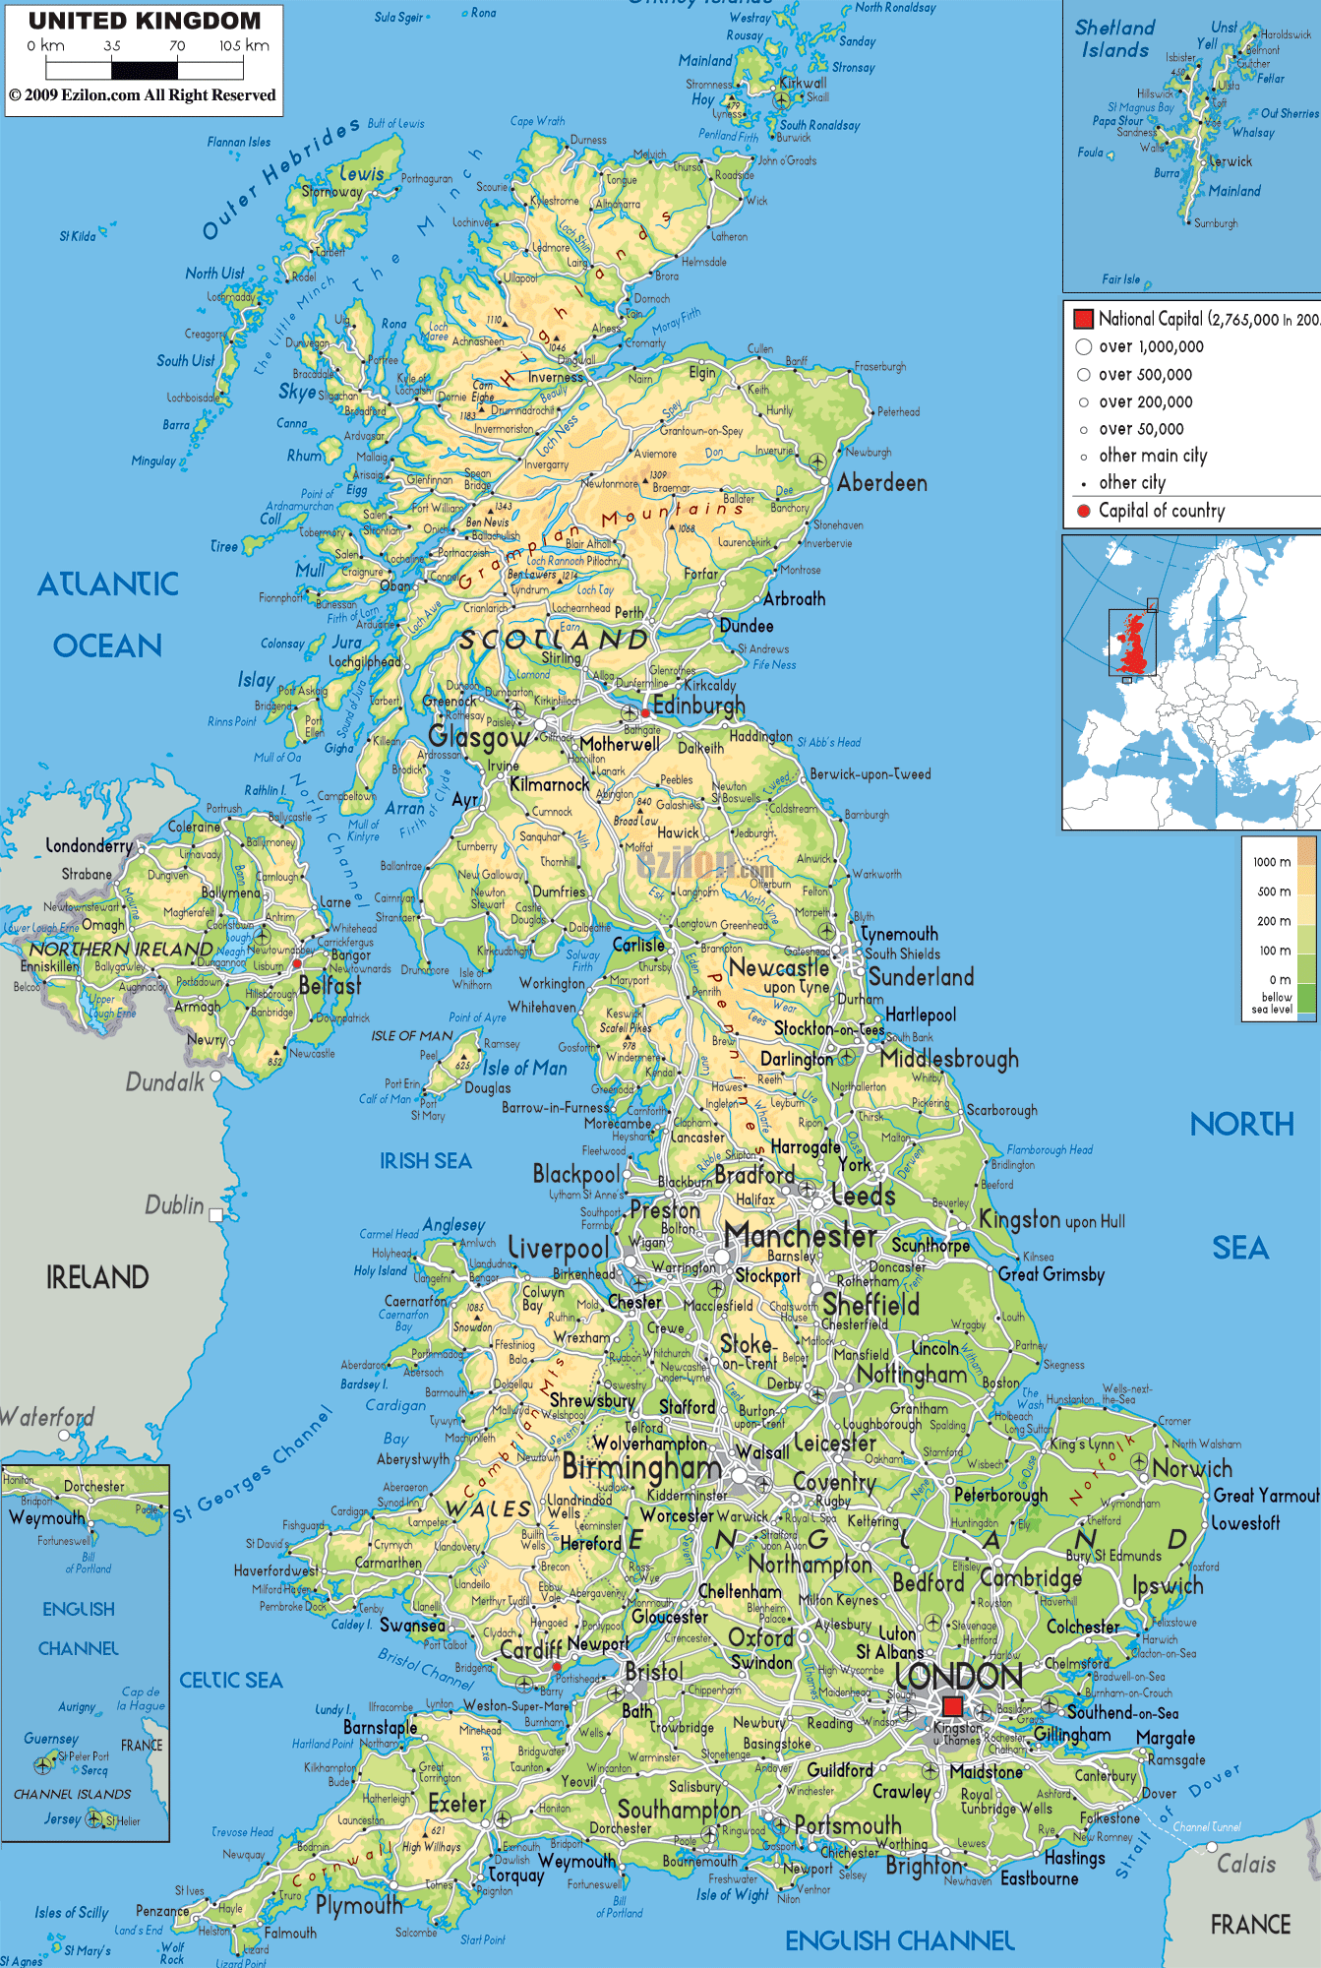
The British experience is central
Tocqueville: “In England writers on the theory of government and those who actually governed co-operated with each other, the former setting forth their new theories, the latter amending or circumscribing these in the light of practical experience. In France, however, precept and practice were kept quit distinct and remained in the hands of two quite independent groups. One of these carried on the actual administration while the other set forth the abstract principles on which good government should, they said, be based; one took the routine measures appropriate to the needs of the moment, the other propounded general laws without a thought for their practical application; one group shaped the course of public affairs, the other that of public opinion.”
Notes:
The British experience is central. We should come to terms with that.

Slide 59
Recap of themes in the genealogy of liberalism 1.0
The ancestral band – cohesionism
Traditional society – cohesionism
Printing rocks their world
Wars of religion → religious toleration, freedom
Refocusing government on lower things
Jurisprudence → commutative justice

Slide 60
Sanctification, moral authorization of pursuit of honest income
Commutative justice has flipside: Liberty
Moral authorization of presumption of liberty
Stable polity in Britain
“liberal” becomes the name for the new outlook
“The liberal plan”: The ideal of the liberal nation-state

Slide 61
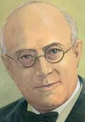
After 1880, Liberalism declined quite suddenly
Many said it declined because it failed.
Other explanations … I can’t go into...
Notes:
After 1880, liberalism declined quite suddenly.

Slide 62
The mentality of governmentalization
Notes:
Social thought shifted dramatically, toward the governmentalization of social affairs, as reflected in the ngrams of these phrases.

Slide 63
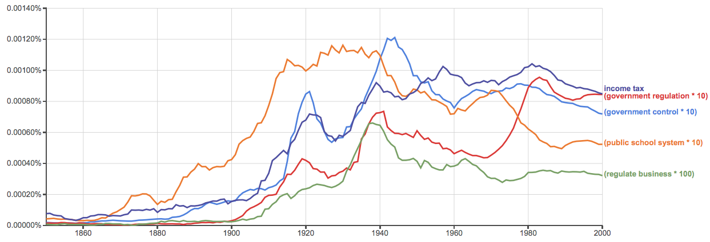
Government institutions
Notes:
And governmentalization rapidly advanced, and kept on advancing.

Slide 64
Words changed or lost meaning
liberal
liberty
freedom
rights
justice
property
contract
equality, equity
law, rule of law
Notes:
The central terms of liberal civilization changed or lost meaning, notable the word “liberal” itself.

Slide 65
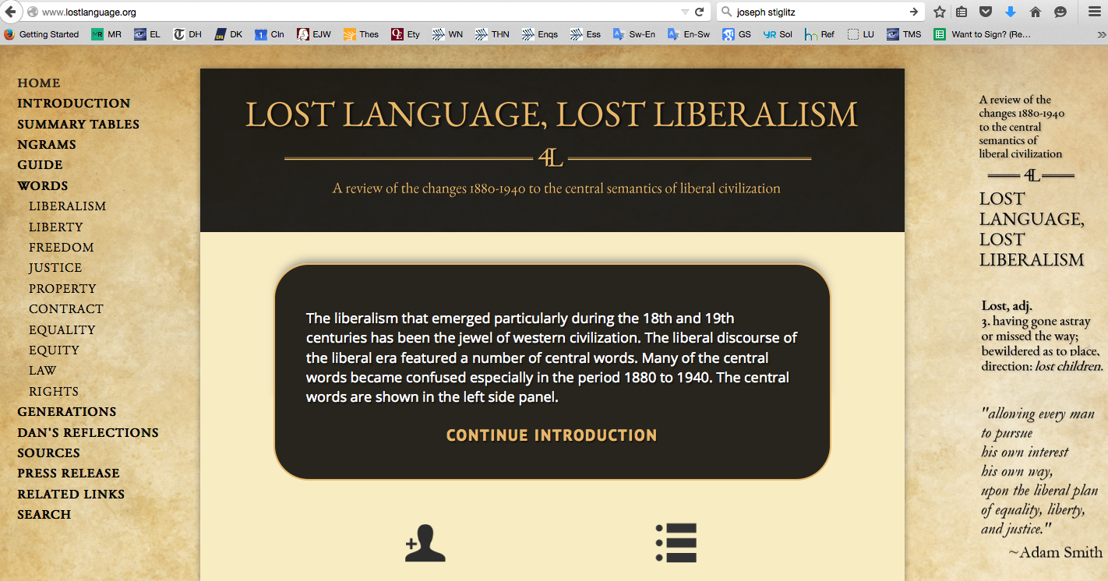
Notes:
At this website Ryan Daza and I have created compedia of quotations showing the semantic changes and the reactions to the changes.

Slide 66
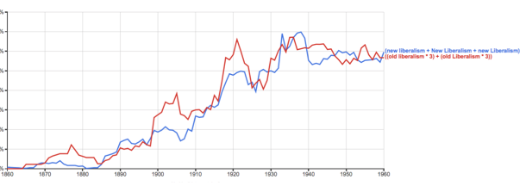
“New Liberalism”
Notes:
“Liberal” changed or lost meaning. In fact, people spoke of a “new liberalism”, and others had to resort to speaking of “old liberalism.”

Slide 67
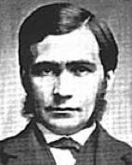
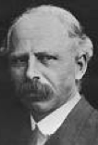
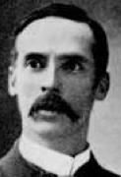
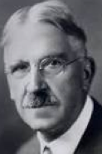
Three faces of “liberal”
Liberalism 1.0: The presumption of liberty
Democratism (see Wolin p. 263)
The governmentalization of social affairs
T.H. Green L.T. Hobhouse J.A. Hobson J. Dewey J. Stiglitz
Notes:
It is useful to think of three faces of liberalism…

Slide 68
Liberalism 1.0 Leftism
?
⬄
→←
Notes:
Left-liberals often say that they are true to the values of the original liberalism, it’s just that conditions have changed, and the new conditions call for different policies to serve those enduring values: liberalism ⬄ leftism
I don’t buy that. I see fundamental tension between liberalism 1.0 and leftism.

Slide 69
The ancestral band
Notes:
I think leftism indulges a cohesionism within us from the ancestral band.

Slide 70
Hayek atavism thesis
“The Atavism of Social Justice,” New Studies in Philosophy, Politics, Economics and the History of Ideas, 1978.
Law, Legislation and Liberty, Vol 2: The Mirage of Social Justice, 1976, esp “The Discipline of Abstract Rules and the Emotions of Tribal Society.”
“The Three Sources of Human Values,” Epilogue to Law, Legislation and Liberty, Vol 3: The Political Order of a Free People, 1979.
The Fatal Conceit: The Errors of Socialism, 1988, esp “Between Instinct and Reason”
Essay on David Hume, in Studies volume, 1967.
Notes:
This is Hayek’s atavism thesis about modern politics, that modern politics of the democratic nation-state have clicked into a powerful but misguided cohesionist penchant, and promotes the governmentalization of social affairs.

Slide 71
Left is reactionary
ancestral band Modern Yearning
The people
(cohesion)
Governor (S)
citizen (i)
(discohesion)
The people
(cohesion)
Left yearns for thicker collectivism of higher things: Cohesionism
Notes:
In this manner we see the left as a reaction to the discohesion within the liberal polity, and as looking to restore social cohesion through governmentalization.

Slide 72
Liberalism 1.0 Leftism
→←
Presumption of liberty → ← “regulation,” “nudge”
Opposition to governmentalization → ← Relish for governmentalization
Small government → ← big government
Simple rules → ← complicated, voluminous rules, bureaucracy
Keep government out of higher things → ← Have government tend and lead higher things
Don’t police inner thoughts → ← punish “bad” thoughts, speech
Subdivide ownership → ← People’s overlordism (feudalism)
Government is coercive → ← government is voluntary
Notes:
The fundamental tension can be seen in many dimensions…
IT WASN’T FOR NOTHING THAT HAYEK TITLED HE APPEAL AGAINST DEMOCRATIC SOCIALISM THE ROAD TO SERFDOM.

Slide 73
Political sensibilities Hume-Smith Leftism
an indeterminate whole
no final validator
disjointed knowledge
open-society sympathies
society as spon. order
no literal vast cooperation
emphasis on commutative justice
a determinate, immanent whole
a final validator
common knowledge
the people’s romance
society as an organization
a vast cooperation
“social justice”
Notes:
And the fundamental tension can be seen in still other matters of political sensibilities…

Slide 74
Madison, Federalist #10
“By a faction, I understand a number of citizens, whether amounting to a majority or a minority of the whole, who are united and actuated by some common impulse of passion, or of interest, adversed to the rights of other citizens, or to the permanent and aggregate interests of the community.”
Notes:
I think that the left, broadly conceived, can, in Madison’s terms, be regarded as a faction, even if it is a majority. I see the recent Republican victory in the United States somewhat in these terms: An array of non-left factions, even differing greatly from one another, voted Republican in opposition to the left faction.

Slide 75
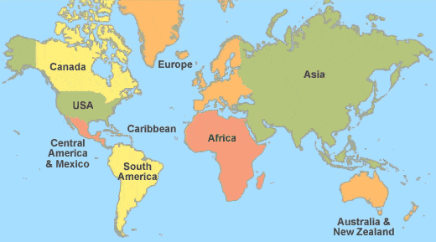
Liberalism and the world
Notes:
In much of the world “liberal” still means liberal 1.0. In fact, that is largely the case here in Sweden.

Slide 76
Communication technology
We can communicate with Aussies, Czechs, and Guatemalans.
People naturally seek moral authority.
We can commune with personalities of the past.
Grotius, Hume, and Smith grow less distant.
Notes:
Communications technology enables us to communicate with people around the world. And nowadays they more often speak English.
People natural seek moral authority.
New technology also enables us to commune with personalities of the past.
Although the years pass, in a way Grotius, Hume, and Smith grow less distant because we can more easily enter into their thinking.
These considerations lead us to renew our focus on liberalism 1.0.

Slide 77
Conclusions
Liberalism 1.0 is the spine of the modern open society
Liberalism 1.0 leans against governmentalization
Liberalism 1.0 upholds a presumption of liberty
Liberalism 1.0’s paramount figure is Adam Smith
Liberalism 1.0 recognized complications and compromises
Liberalism 1.0 is basically at odds with leftism

Slide 78
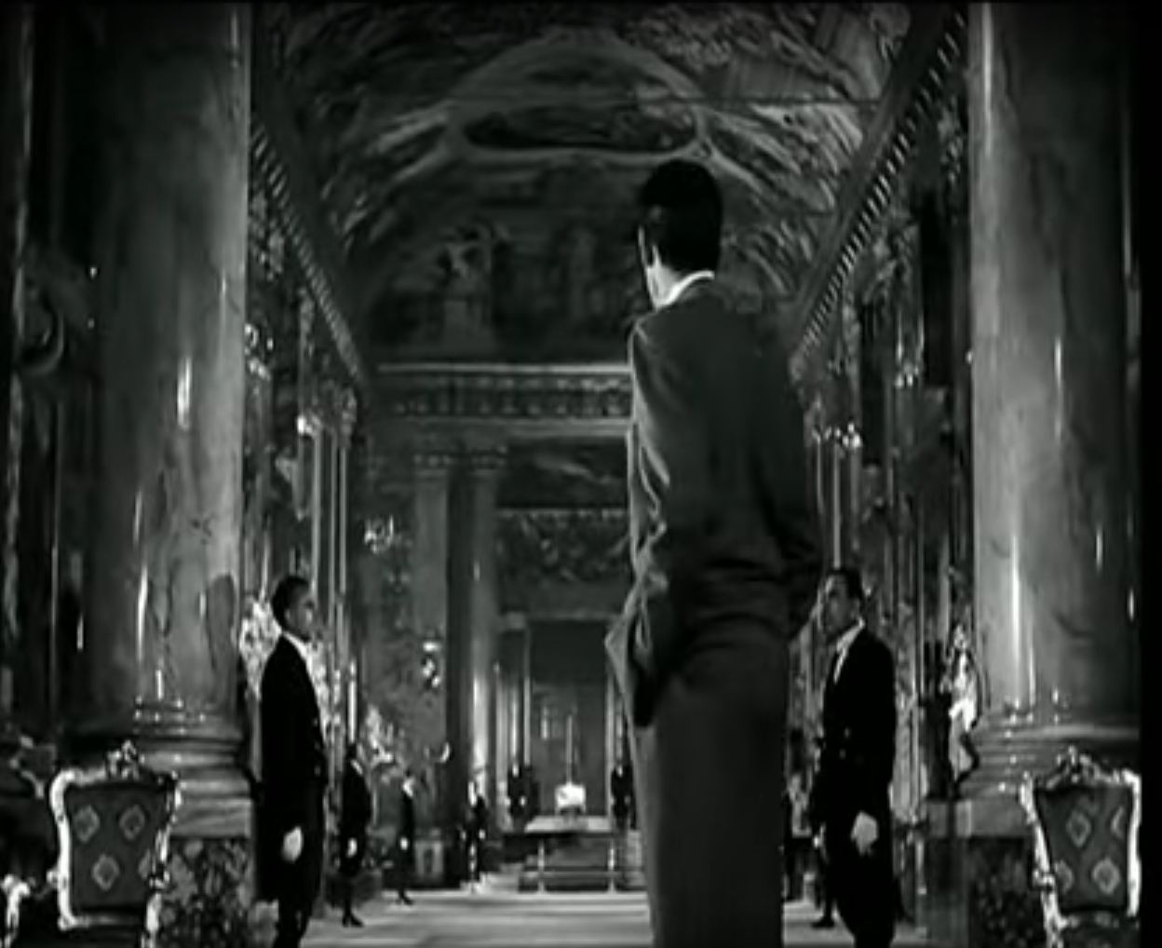
Notes:
This shot if from the end of Roman Holiday. It is to remind us that the higher things are your responsibility. Liberalism does not supply them. Liberalism is only a political persuasion. It is not a philosophy of life.
Clerical versus laical liberalism.

Slide 79
Thank you for your attention.

